Slide 1
Flight Prices Prediction Presentation
Introduction by:
Mohamed yasser
Eslam belal
Tarek samy
Ahmed galal

Slide 2
Project analysis slide 2
Project Analysis
Questions
Domain
PROJECT
ANALYSIS
Dataset
Machine learning

Slide 3
Project analysis slide 4
Domain of Predict Price of Airline Tickets data
The price of the ticket varies from flight to flight and according to the month of the trip
For example, in the month of june, we noticed an increase in the number of flights due to the Christmas holidays, so the ticket price increases
Through the data, we also noticed that the ticket price increases if the flight stops more than once in more than one airport(have many hours), but its price is low if it is direct,
Tasks
Management Objectives
Schedules
Resources

Slide 4
Project analysis slide 5
What are the question help us for what we need from this data?
Does price vary with Airlines?
How is the price affected when tickets are bought in just 1 or 2 days before departure?
Does ticket price change based on the departure time and arrival time?
How the price changes with change in Source and Destination?
How does the ticket price vary between Economy and Business class?

Slide 5
Project analysis slide 6
Dataset
Source City: City from which the flight takes off. It is a categorical feature having 6 unique cities.
Departure Time: This is a derived categorical feature obtained created by grouping time periods into bins. It stores information about the departure time and have 6 unique time labels.
Airline: The name of the airline company is stored in the airline column. It is a categorical feature having 6 different airlines.
.
Departure Time
Airline
Source City
Duration: A continuous feature that displays the overall amount of time it takes to travel between cities in hours.
Destination City: City where the flight will land. It is a categorical feature having 6 unique cities.
Duration
Destination City
Arrival Time
Stops
Arrival Time: This is a derived categorical feature created by grouping time intervals into bins. It has six distinct time labels and keeps information about the arrival time.
.
.
Stops: A categorical feature with 3 distinct values that stores the number of stops between the source and destination cities.

Slide 6
Project analysis slide 8
We will answer this questions in predictions
How is the price affected when tickets are bought in just 1 or 2 days before departure?
Does ticket price change based on the departure time and arrival time?
How does the ticket price vary between Economy and Business class?
Does price vary with Airlines?
Does ticket price change based on the departure time and arrival time?
How the price changes with change in Source and Destination?
Does the number of stops influences the price?
What variables influence most the price?

Slide 7
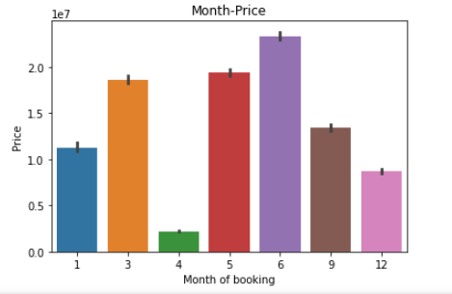
Project analysis slide 10
Project Analysis
Relation between month booking and month price

Slide 8
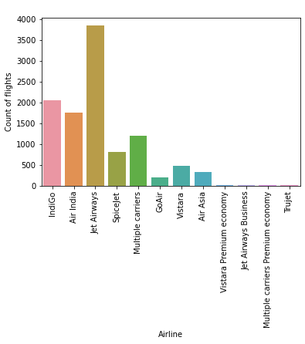
Project analysis slide 10
Project Analysis
Relation between count flights and companies

Slide 9
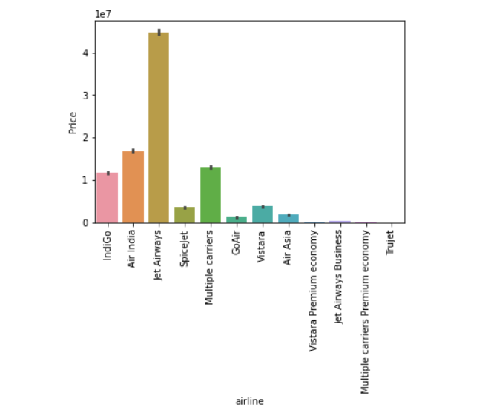
Project analysis slide 10
Project Analysis
Relation between companies and airline Price

Slide 10
Project analysis slide 10
Machine learning
is a field of data science that focuses on designing algorithms that can learn from and make predictions on data.
Model we used in this project :
Linear regression model
It used for continuous data
connect two relationship
Y=A0+ A1 X
Accuracy :
If accuracy increase the model LEARN better
cant accuracy will be 100%

Slide 11
Thank You

